Slide 1
SCHOOL INFORMATION SYSTEM
Mutia Ayu Dianita
MuhamAD hudya Ramadhana
Radityo harimurti

Slide 2
Background

Slide 3
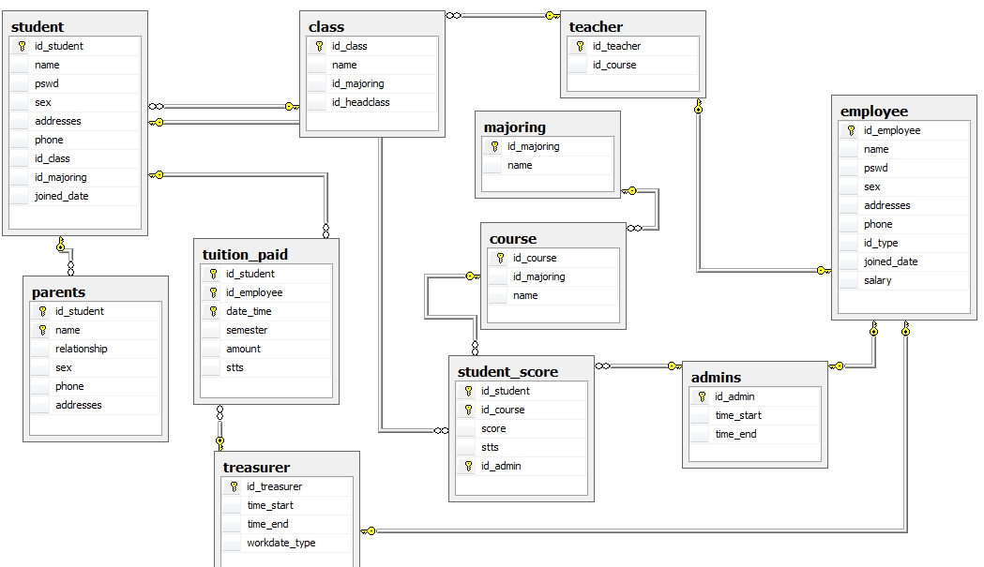

Slide 4
QUERY
-- CREATE DATABASE --
create database SIS;
-- USE DATABASE --
use SIS;

Slide 5
-- CREATE TABLE --
create table student(
id_student char(5) not null primary key,
name varchar (50),
pswd varchar (50),
sex char(1),
addresses text,
phone varchar (12),
id_class char (5),
id_majoring char (5),
joined_date date,
);

Slide 6
Constraint
--constraint student
alter table student add constraint chk_id_student check (id_student like 'S%%%%');
alter table student add constraint chk_sex check (sex like 'M' OR sex like 'F');
alter table student add constraint chk_phone_student check (phone like REPLICATE('[0-9]',0-12))

Slide 7
Foreign Key
--- FK ----------
alter table parents add foreign key (id_student) references student (id_student)
alter table course add foreign key (id_majoring) references majoring (id_majoring)
alter table student add foreign key (id_class) references class (id_class)
alter table class add foreign key (id_majoring) references majoring (id_majoring)
alter table class add foreign key (id_headclass) references teacher (id_teacher)
alter table teacher add foreign key (id_teacher) references employee (id_employee)
alter table Admins add foreign key (id_admin) references employee (id_employee)
alter table treasurer add foreign key (id_treasurer) references employee (id_employee)

Slide 8
Select
select * from student;
select * from student_score;
select * from course;
select * from parents;
select * from teacher;
select * from class;
select * from majoring;
select * from teacher;
select * from tuition_paid;
select * from employee;
select * from admins;

Slide 9
Trigger
--Check Score
create trigger tr_chk_score on dbo.student_score
after insert,update
as
declare @score int
begin
select @score = score from inserted
if (@score > 75)
update student_score set stts = 'Y'
else
if (@score < 75)
update student_score set stts = 'N'
end

Slide 10
Procedure
----- auto spec id course
create procedure autospecidcourse
@id_majoring char (5),
@name varchar (50)
as
declare @id_course char(5)
if exists(select id_course from course where id_course = 'P0001')
begin
select @id_course = MAX(right(id_course ,3)) from course
select @id_course =

Slide 11
case
when @id_course >=0 and @id_course <10 then 'P000' + CONVERT(char(5),@id_course + 1)
when @id_course >=10 and @id_course <100 then 'P00' + CONVERT(char(5),@id_course + 1)
when @id_course >=100 and @id_course <1000 then 'P0' + CONVERT(char(5),@id_course + 1)
end
end
else
insert into course values('P0001',@id_majoring,@name)
insert into course values(@id_course,@id_majoring,@name)
go
exec autospecidcourse 'M0001','Bahasa Jerman'

Slide 12
View
----- VIEW ------
create view vscore as
select A.id_student as id_s,A.name, B.score as score, B.stts as statuss,
C.name as name_course from student A, student_score B, course Cwhere
A.id_student = B.id_student AND C.id_course = B.id_course
select id_s,name,name_course,score,statuss from vscore where statuss = 'N'
select id_s,name,name_course,score,statuss from vscore where statuss = 'Y'
select id_s,name,name_course,score,statuss from vscore where score > 78

Slide 13
Security
create user raditt
for login radit
create user mutiad
for login mutia
use SIS
GRANT CREATE PROCEDURE,CREATE TABLE,CREATE FUNCTION
to mutiad
use SIS
GRANT DELETE,INSERT,SELECT,UPDATE
to raditt

Slide 14
Backup
---BACKUP
BACKUP DATABASE SIS
to disk= 'C:\Program Files\Microsoft SQL Server\MSSQL10_50.DHANA\MSSQL\Backup\SIS.bak'
WITH FORMAT
GO
BACKUP LOG SIS
to disk= 'C:\Program Files\Microsoft SQL Server\MSSQL10_50.DHANA\MSSQL\Backup\SIS.bak'
GO

